Slide 1
BOOK STORE MANAGEMENT SYSTEM PROJECT
GROUP 19

Slide 2
Our team has 4 members:
Nguyễn Bá Ngọc Minh Ba9-042
Bùi Quang Hà Bi10-052
Phạm Trung Kiên Bi10-089
Trần Hoàng Minh Bi10-119

Slide 3
Contents
Introduction
Structure
Demo
Conclusion
Definition
Module and Package
Purpose of the software
Function
Idea of the software
Idea of the software

Slide 4
Introduction

Slide 5
Definition
Book Store Management System is the web application to automate all kinds of operations in the book shop
A system that was built using knowledge about programming language (Python) to create functions, methods, packages

Slide 6
Purpose of the software
Easier manage the number of books in the bookstore.
Can memorize thousands of different books.
Avoid losing books in the store.
Manage the import and export of each different book item.

Slide 7

Idea of the software
FORREST BOOKSTORE MANAGEMANT
BOOKS
DETAILS
ID
NAME PRICE YEAR PUBLISHER AUTHOR QUANTITY
1
2
3
4
5
6
7
Save
List all
Clear
Delete
Update
Search
Close

Slide 8
Structure

Slide 9

Module and package

Slide 10
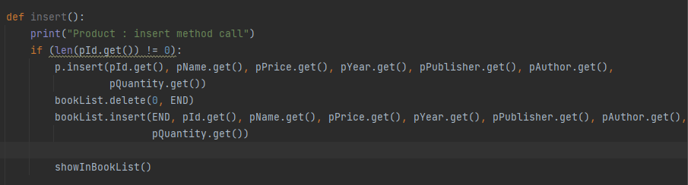
Save

Slide 11
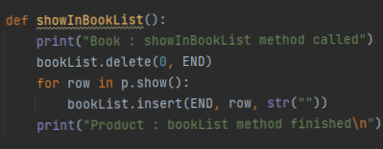
List all

Slide 12
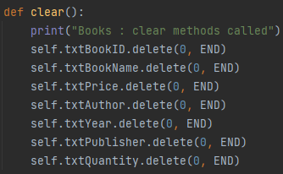
Clear

Slide 13
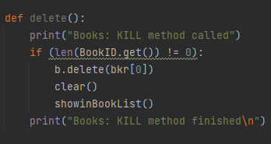
Delete

Slide 14
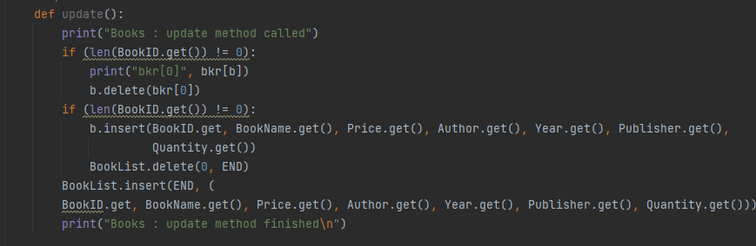
Update

Slide 15
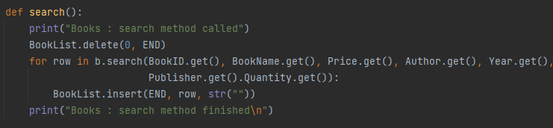
Search

Slide 16
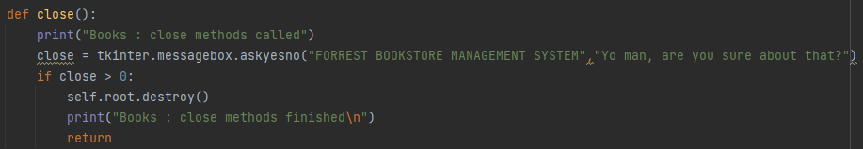
Close

Slide 17
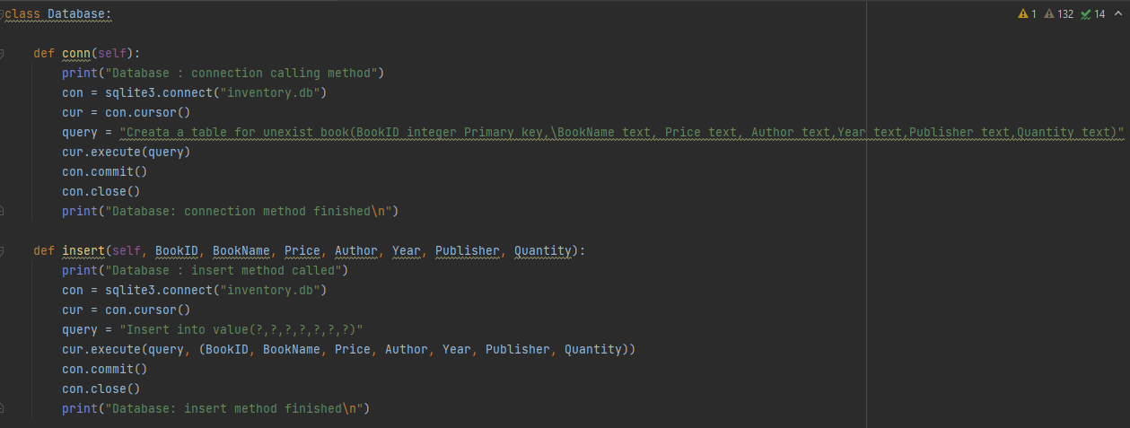
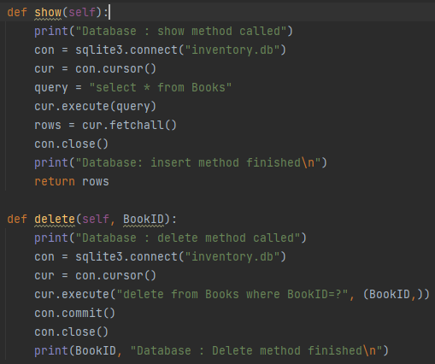
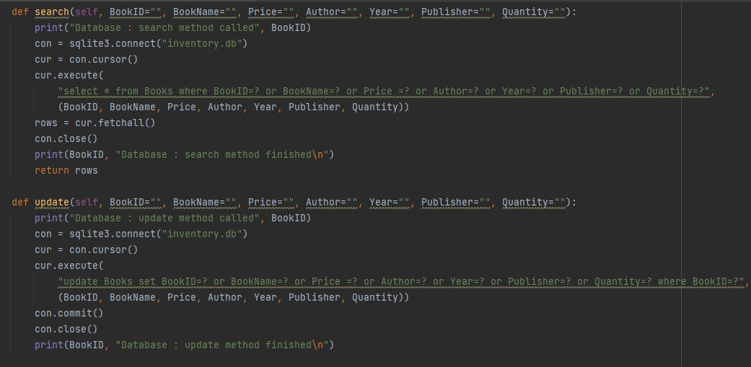
Database

Slide 18
Demo

Slide 19
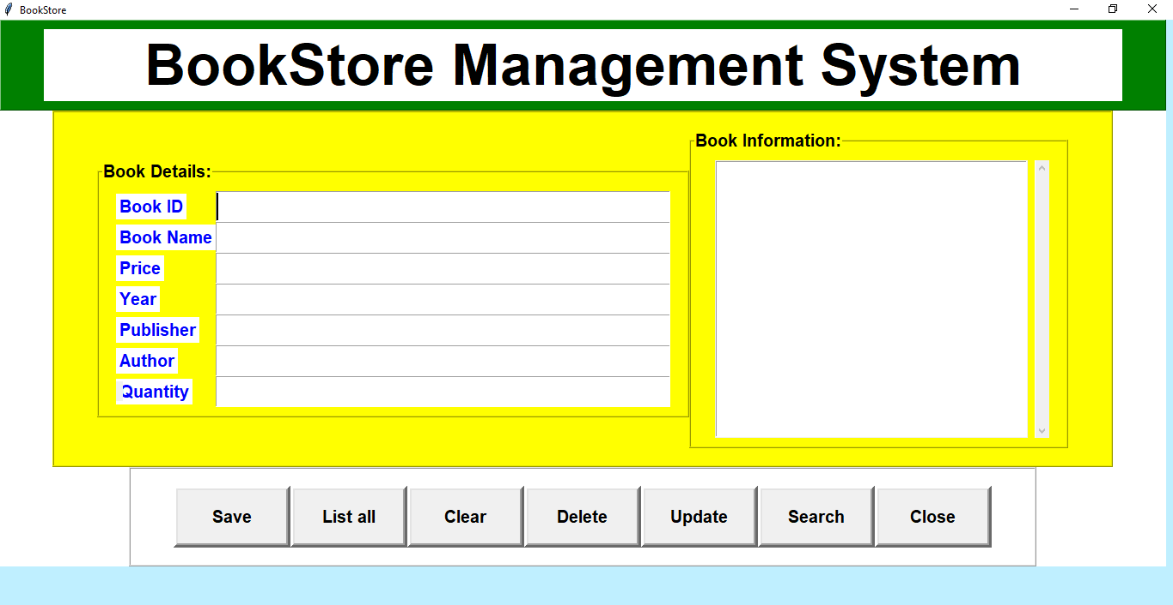

Slide 20
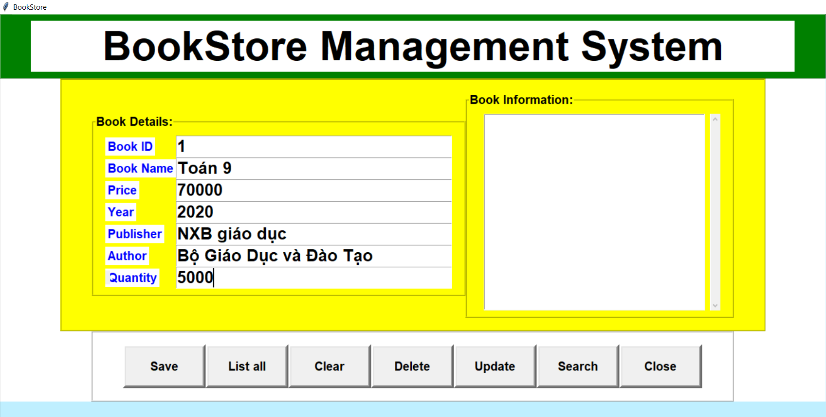

Slide 21
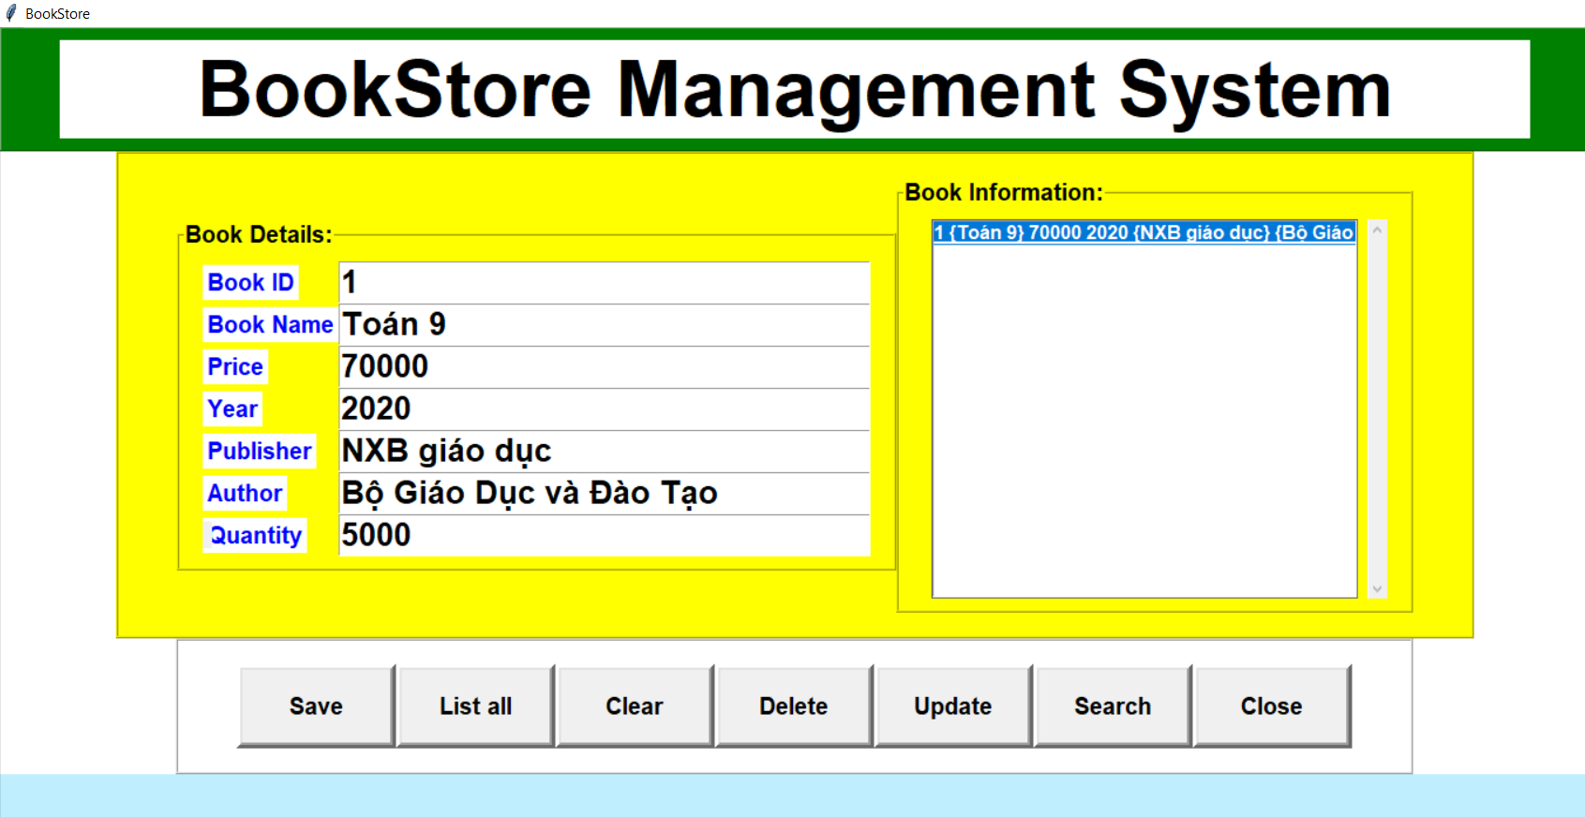

Slide 22
Conclusion

Slide 23
During the development process we have learned
We have learn how to make a system user friendly
Basic concepts about Advanced Programming with Python.
Skills and knowledge from Basic Database.
Modules, packages,…

Slide 24


